Slide 1
Trigger: Collection review cycle or new open items
Run Behavioral insights scoring (Scheduled or on demand triggering)
Review prioritized risk list and key drivers
High risk or action needed?
Yes
No
select strategy (dunning, call, payment plan)
Standard follow-up and monitor the activities for potential high risk
Execute actions in SAP. Update status and capture outcome
Yes
Paid or resolved?
No
clear items, close case, report KPIs
escalate, adjust strategy, re-run scoring

Slide 2
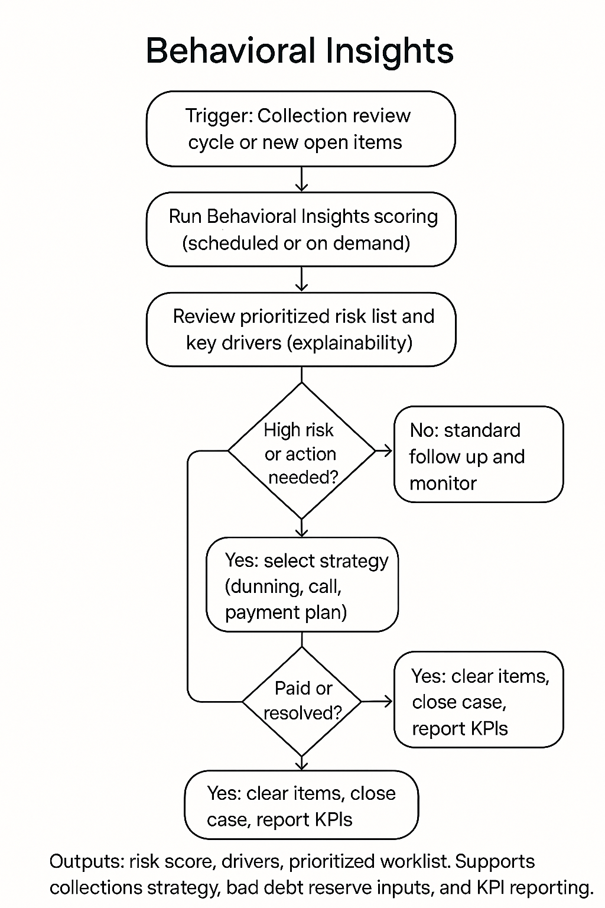
Trigger: Collection review cycle or new open items
Run Behavioral insights scoring (Scheduled or on demand triggering)
Review prioritized risk list and key drivers
High risk or action needed?
Yes
No
select strategy (dunning, call, payment plan)
Standard follow-up and monitor the activities for potential high risk
Execute actions in SAP. Update status and capture outcome
Paid or resolved?
Yes
No
clear items, close case, report KPIs
escalate, adjust strategy, re-run scoring

